Slide 1
Mini Popper | Colt poppers | Pepper poppers | Plates | Wall feet
6 | 5 | 0 | 0 | 64
Bay | Stage | Target Type | Count | NS | Total | Hard Cover
A3 | Riptide Run | IPSC | 8 | 2 | 10 | 2 Left Diag 1 Right Diag
A2 | 19-03 | USPSA | 2 | 2 | 4 | 4 action target, 5” down from shoulder perf
B1 | Portside Pain | USPSA | 12 | 4 | 16 | 1 Tux 1 Left Diag 1 50%
B2 | Boxed in Blitz | USPSA | 9 | 1 | 10 | 2 Tux 1 Right Diag 2 50%
B3 | Stairway to Nowhere | USPSA | 9 | 1 | 10 | 1 Right Diag
B4 | Rythm Reload | IPSC | 3 | 1 | 4 | 1 Right Diag

Slide 2
Prop | Stage
Swinger, max trap | Stage 3, B1
Pull port | Stage 3, B1
Swinger | Stage 6, B4
Type | Type | Count
IPSC | Tux | 0
IPSC | Left Diag | 2
IPSC | Right Diag | 2
IPSC | 50.00% | 0
USPSA | Tux | 3
USPSA | Left Diag | 1
USPSA | Right Diag | 2
USPSA | 50.00% | 7

Slide 3

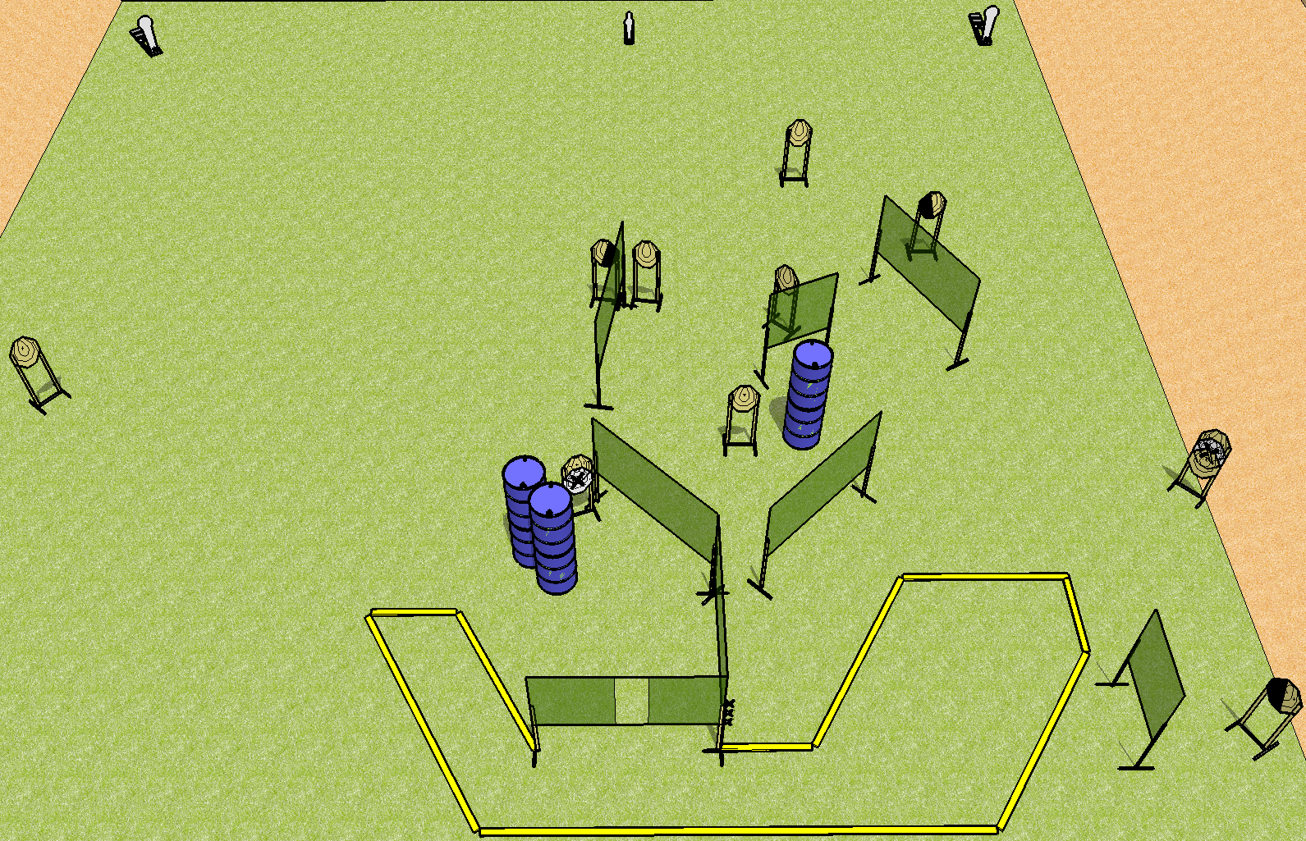
 | Dothan Practical Shooters – USPSA Match Riptide Run Course Designer : Drew Coleman Bay: A3
Round Count 25 rounds 11 IPSC 2 colt poppers, 1 mini popper
Equipment List 15 wall feet 2 left diag, 1 right diag 10 targets (8 + 2NS)

Slide 4
Riptide Run
Written Stage Briefing
Scoring: Comstock Rounds: 25 rounds
Targets: 11 IPSC, 3 steel
Handgun start position: hands touching marks, handgun is unloaded and holstered.
PCC start position: muzzle touching mark, stock on belt. Unloaded carbine is held with both hands.
Stage Procedure: on the audible start signal, engage targets as they become available from within the shooting area.

Slide 5
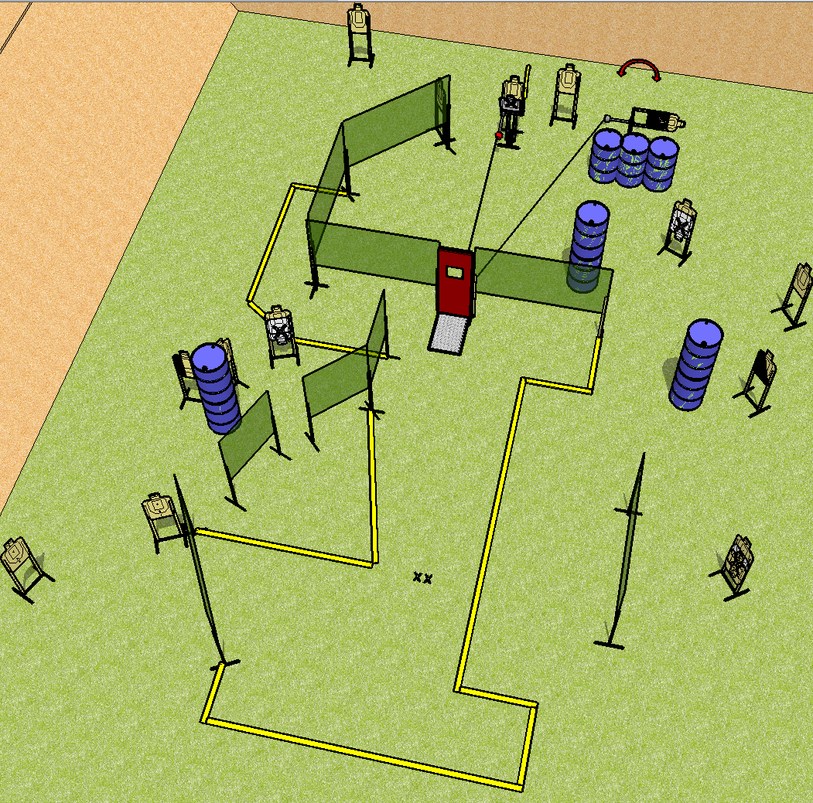
 | Dothan Practical Shooters – USPSA Match Portside Pain Course Designer : Drew Coleman Bay: B1
Round Count 30 rounds 15 USPSA
Equipment List 17 wall feet Pull cord port Max trap + swinger + cables to the pull cord 1 tux, 1 right diag, 1 lower 1/3rd hard cover, 15 targets (4 NS)

Slide 6
Portside Pain
Written Stage Briefing
Scoring: Comstock Rounds: 30
Targets: 15 USPSA
Handgun start position: feet on X’s, wrists below belt. Handgun is loaded and holstered.
PCC start position: feet on X’s, stock on belt. Loaded carbine is held with both hands, safety on.
Stage Procedure: on the audible start signal, engage targets as they become available from within the shooting area.

Slide 7
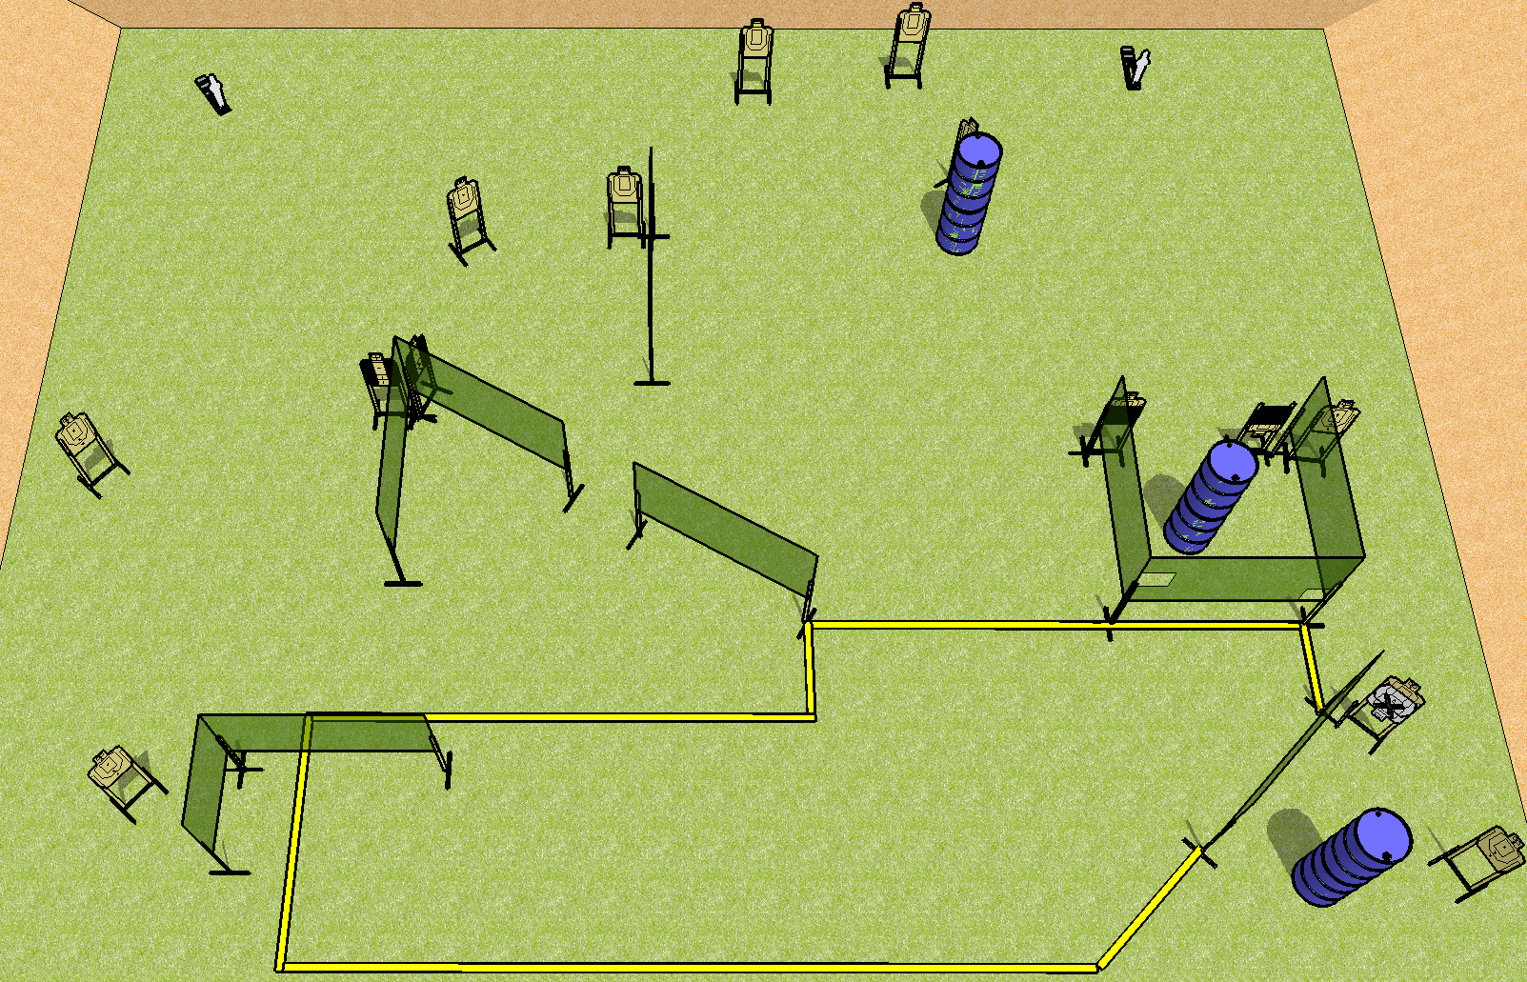
 | Dothan Practical Shooters – USPSA Match Boxed in Blitz Course Designer : Drew Coleman Bay: B2
Round Count 30 rounds 14 USPSA 2 mini poppers
Equipment List 17 wall feet 2 tux, 2 50%, 1 right diag 10 targets (9 + 1NS)

Slide 8
Boxed in Blitz
Written Stage Briefing
Scoring: Comstock Rounds: 30 rounds
Targets: 14 USPSA, 2 steel
Handgun start position: Anywhere completely outside the shooting area, wrists below belt. Handgun is loaded and holstered.
PCC start position: anywhere completely outside the shooting area, stock on belt. Loaded carbine is held with both hands, safety on.
Stage Procedure: on the audible start signal, engage targets as they become available from within the shooting area.

Slide 9
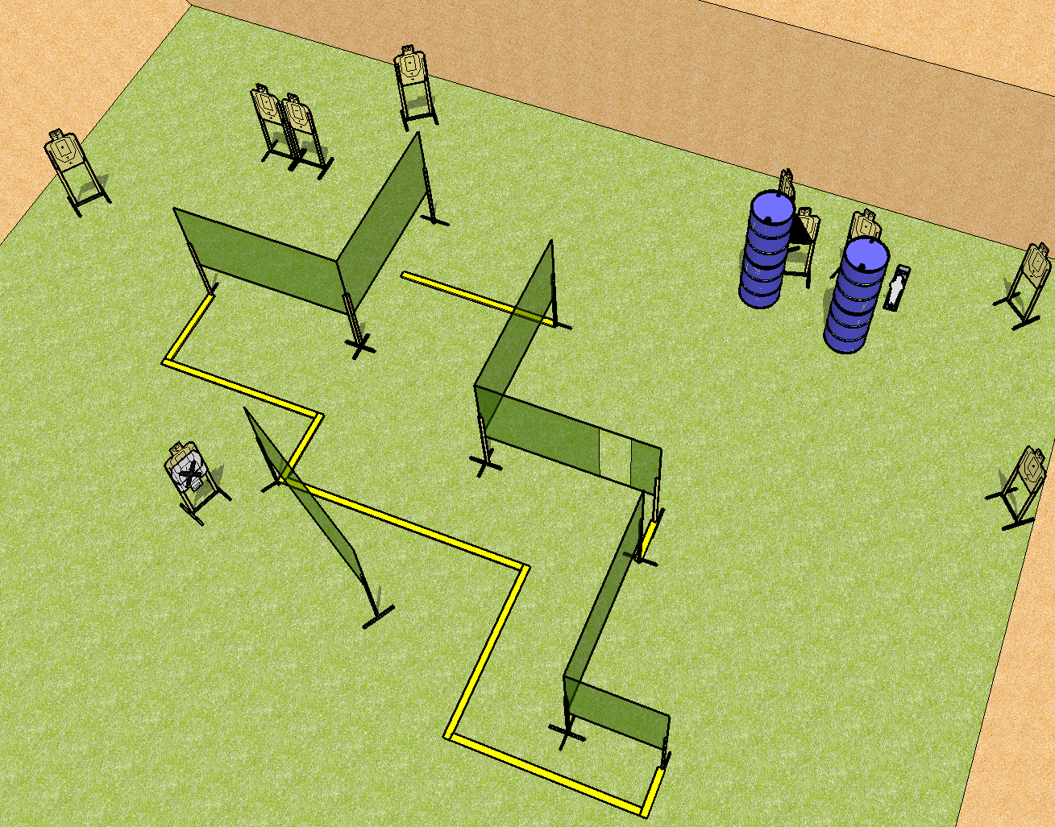
 | Dothan Practical Shooters – USPSA Match Stairway to Nowhere Course Designer : Drew Coleman Bay: B3
Round Count 21 rounds 10 USPSA 1 mini popper
Equipment List 11 wall feet 1 right diag 10 targets (9 + 1NS)

Slide 10
Stairway to Nowhere
Written Stage Briefing
Scoring: Comstock Rounds: 21
Targets: 10 USPSA, 1 steel
Handgun start position: inside the shooting area, wrists below belt. Handgun is loaded and holstered.
PCC start position: inside the shooting area, stock on belt. Loaded carbine is held with both hands, safety on.
Stage Procedure: on the audible start signal engage targets as they become available from within the shooting area.

Slide 11
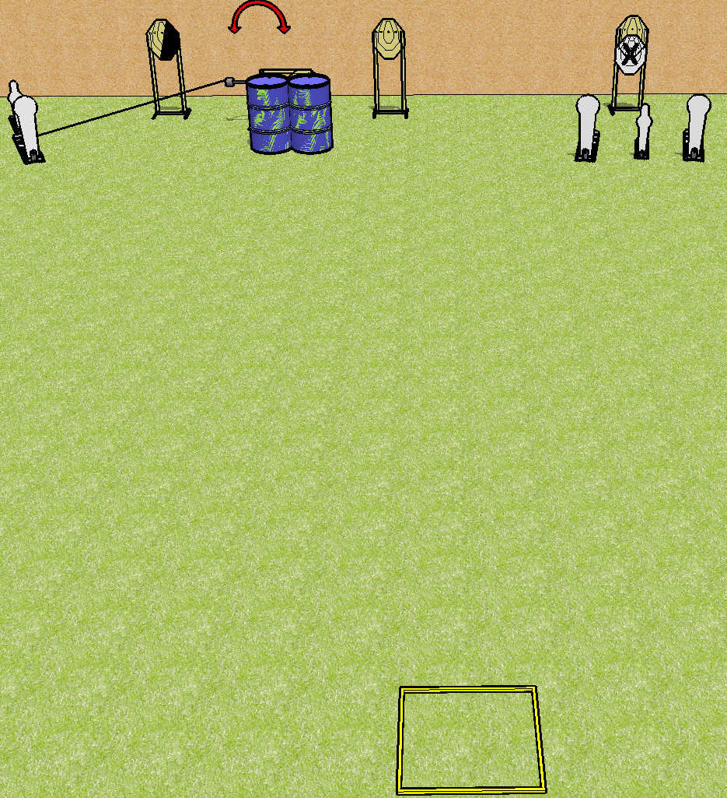
 | Dothan Practical Shooters – USPSA Match Rhythm Reload Course Designer : Drew Coleman Bay: B4
Round Count 13 rounds 4 IPSC 3 colt poppers, 2 mini poppers
Equipment List Shooting box Swinger + activator 1 right diag 4 targets (3 + 1NS)

Slide 12
Rhythm Reload
Written Stage Briefing
Scoring: Comstock Rounds: 13
Targets: 4 IPSC, 5 steel
Handgun start position: inside the shooting area, wrists below belt. Handgun is loaded and holstered.
PCC start position: inside the shooting area, stock on belt. Loaded carbine is held with both hands, safety on.
Stage Procedure: on the audible start signal, engage either array, perform a mandatory reload, then engage the remaining array STRONG HAND ONLY. Array 1 is P1, P2, T1, T2, and T3 (left side of stage). Array 2 is T4, P3, P4, and P5 (right side of stage).

